Slide 2
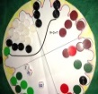
7.2 Four Seasons (Board Game)
Aims:
Participants should be taught to recognize and name two dimensional shapes (circle)
Understand symmetry in shapes
Understand concepts of horizontal and longitudinal lines.
Participants should be taught to count reliably up to 20.
Multiply using single-digit whole numbers
Understand the concepts of double and triple
Determine a next term in linear patterns (e.g., 3, 6, 9, …)

Slide 3
7.2 Four Seasons (Board Game)
Comments on the Course:
Lesson takes 45 Minutes, build a round table each four players.
Each groups needs four series of twelve pawns of four different colours (red, green, white and black)
Prepare copies from the worksheet for each participant.
You can start the lesson explaining how to play the “Four Seasons”.
Give an example of the round board and teach how to build it showing a video
https://www.youtube.com/watch?v=CCFDhtg-G4U&feature=youtu.be
Participants learn to count counting all the pawns.
They learn to add quantities.
They learn that the mental calculation is strategic and flexible; it is guided by the estimation of the possible result.
They practice the game and learn the meaning of double, triple and scale.

Slide 4
7.2 Four Seasons (Board Game)
Hints
At the end of the lesson the worksheet has to be completed.
If the participants cannot read, the teacher has to guide them.
If participants have difficulties to count or do the addiction, they have to train – they need more time.
If participants have difficulties to count, the teacher has to divide the lesson into two lessons: First lesson: play and count by mind, second lesson: play and learn the strategies.
Following lesson: practice game strategies and problem solving

Slide 5
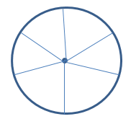
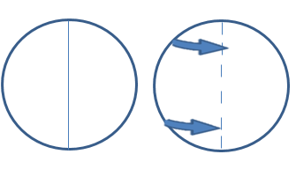
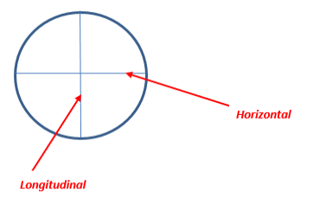
7.2 Four Seasons (Board Game) Section A
Give an example of the circle and ask participants to build a new one, after that to draw lines from the centre to the border and measure the lines.
They realize that they have all the same length!
Ask to draw a line passing through the centre and split the shape into 2 parts folding the paper along the line.
Compare both parts! Both parts are identical.
Ask to fold the paper in half again: the line has to cross the other line, draw a line along the fold.
How many parts has been the circle divided into? Four
Make the participants put the paper so that the lines are one longitudinal and the other one horizontal. Check the position of the lines.
Explain that the straight up and down direction is called “longitudinal or vertical” and the left–to-right one is called “horizontal”.

Slide 6
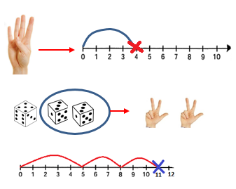
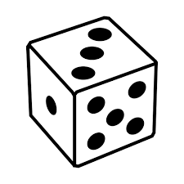
7.2 Four Seasons (Board Game) Section B
Start the game
Introduce the concept of double and triple by rolling dice.
Make the participants represent single digit numbers using the fingers and the number line.
Represent on the number line the numbers on the dice one by one.
Let’s focus on the final number. It is the total of the addition.
Now make the same with the fingers. Count them. 5+3+3 = 11
Represent directly the numbers of the dice on the number line: 3 and the other 3 and let them use a cross to mark the numbers.
Tell them that a number repeated twice is called “double”.
Make them practice double with other numbers (using their fingers): 2 → 4; 4 → 8…
Tell them that a number repeated twice is called “double”.
Make them practice double with other numbers (using their fingers): 2 → 4; 4 → 8…

Slide 7
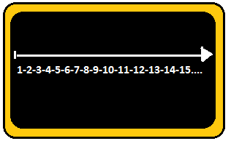
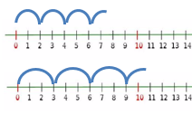
7.2 Four Seasons (Board Game) Section B
Make the participants repeat the exercise with 3 dice:
3, 3, 3 jumping on the number line
Teach them that a number repeated three times is called “triple” and make them practice
What is the triple of 2? 6
What is the triple of 3? 9
Now draw on the blackboard a longer number line to practice with higher numbers.
What is the double of 7? 14
What is the triple of 4? 12
What is the triple of 5? 15
Make the participants determine the next rhythm pattern in the number line.
Try 2 by 2
Try 3 by 3
within the number 20 on the line

Slide 8
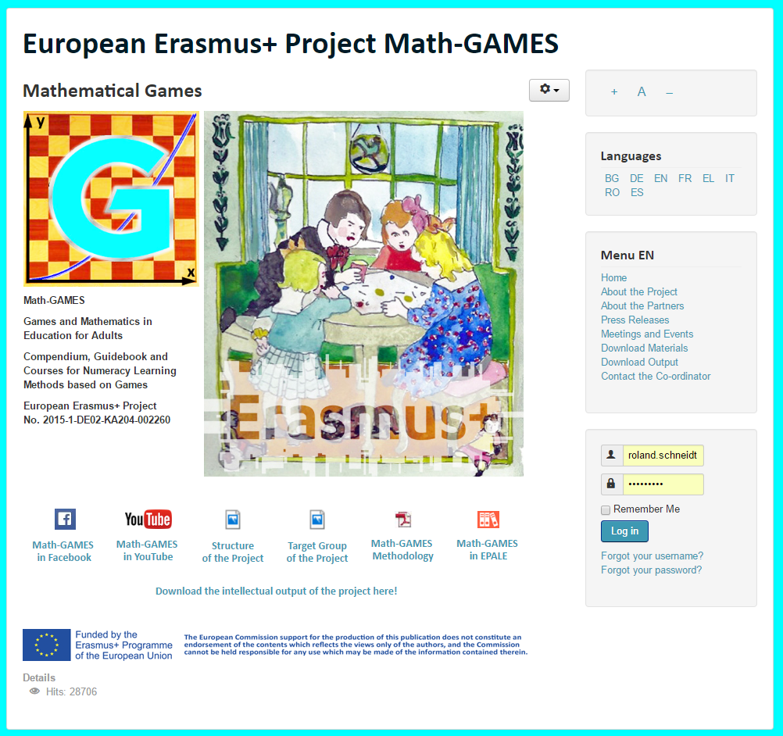
The result is: Play Games and and learn Mathematics more easily.
Our Project-Website will help you: www.math-games.eu

